Slide 1
Movie Rating Prediction
By: Ryan Fisher
2/24/21

Slide 2
Introduction
Problem Statement
Before seeing a movie, the first question most people ask is, “is it good?” Everyone wants to know how good a movie is before seeing it. What if we could predict how a movie will be reviewed based on different features of that movie?
Goal
Using a data driven analysis and machine learning modeling techniques, we want to know if we can predict the rating a movie will get in order to help users determine if they want to see that movie.

Slide 3
Data Acquisition
The data comes from Kaggle and contains movies from the MovieLens Dataset released through July 2017.
Contains seven csv files
Four different files with movie data
Three files we are not interested in using for this project.
They contain links to the IMDB and TMDB websites for each movie. This data is not needed to do our prediction.
Fourth file is a keyword file that has different keywords describing movies. At this moment, this file is out of scope for this project.

Slide 4
Data Acquisition
Movies - “movies_metadata.csv”
features specific to each movie.
budget
revenue
collection
genre
runtime
title
overview
popularity
production studio
language
release date
vote average
vote count

Slide 5
Data Acquisition
Credits - “credits.csv”
This file contains cast and crew data for each movie.
Three features
“cast” dictionary, “crew” dictionary, and id
Ratings - “ratings.csv”
Two files related to ratings
One file is a full dataset of ratings
Second file is a smaller version with less rows.
Since we have the vote_average in the movie_metadata file, we will use that instead of merging this file to our dataset.

Slide 6
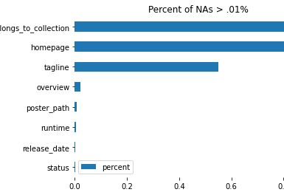
Data Wrangling
Data for each file was loaded into three different dataframes using Pandas.
movies, credits, and ratings.
Null values
movies features that had null values made sense and they weren’t necessarily going to be an issue for our analysis. Not every movie belongs to a collection, so that makes sense.
credits dataframe had zero null values
movies and credits were merged into a new dataframe

Slide 7
Data Wrangling - Creating and Cleaning Features
After merging the dataframes dictionaries were split into different columns.
“belongs_to_collection” and “production_companies”
This feature contained a dictionary of the name of the collection and the collection’s ID
Any movies that were not in a collection were NaN
To split out the collection name, I did a for loop that used iterrows to loop through the dictionaries and stored the name to an empty list.
The list with collection names was then added to the dataframe

Slide 8
Data Wrangling - Creating and Cleaning Features
“genres”
This feature contained a dictionary of genres for each movie
Some movie had multiple genres
The first genre was the main genre and was where I focused
I performed a for loop using iterrows like above.

Slide 9
Data Wrangling - Creating and Cleaning Features
“cast”
The cast feature was a little more tricky
This feature contained a dictionary with the actor name, character name, id, credit id, gender, order, and profile path
I used the ast package to read this dictionary and identify the top 5 actors
Using the literal_eval method from the ast package, I was able to read the dictionary
I am only interested in the top 5 actors since some movies may have a lot of actors and the top 5 actors would be the highest billed actors since they are listed in billing order
I used a for loop and iterrows with literal_eval to identify the order of the actors and added a temporary dictionary to store the actor names and appended that dictionary to an empty list before the for loops.
This gave me a list of the top 5 actors for each movie
To read this list better, I split the list and added a comma between each actor
This was then added to the movies_credits dataframe

Slide 10
Data Wrangling - Creating and Cleaning Features
“crew”
The crew feature was similar to the “cast” feature
It contained a dictionary with all of the crewmembers.
I was only interested in the director name
Using literal eval from the ast package, I performed a similar loop, except instead of looking for the order number, I used the “job” field in this dictionary and only stored names of people with the job of “Director.”
This list was then added to the movies_credits dataframe

Slide 11
Data Wrangling - Creating and Cleaning Features
A and B List Actors
In order to use the actors in our modeling, I needed to find a way to make them numeric. I thought it might be interesting to see if the number of A list actors and B list actors has an effect on the rating.
I found a list of the top 1000 actors and imported that as a new dataframe called top_actor_list
This dataframe contains the rank, created, modified, name, known for, and birthdate fields
I created two new lists that stored actors in position <= 500. This list was called a_list_actors
Any actor in position greater than 500 was added to a list called b_list_actors

Slide 12
Data Wrangling - Creating and Cleaning Features
“a_list_sum” and “b_list_sum”
Now that I have the A and B list actor lists, I need to count how many of these actors are in the lists within the movies_credits dataframe
I did a for loop using iterrows and added 1 to a list if there was a match. I think summed up the numbers for each movie and that number was stored in another empty list as the sum of the actors
I did this for both A List and B List actor lists
These new features were added to the dataframe

Slide 13
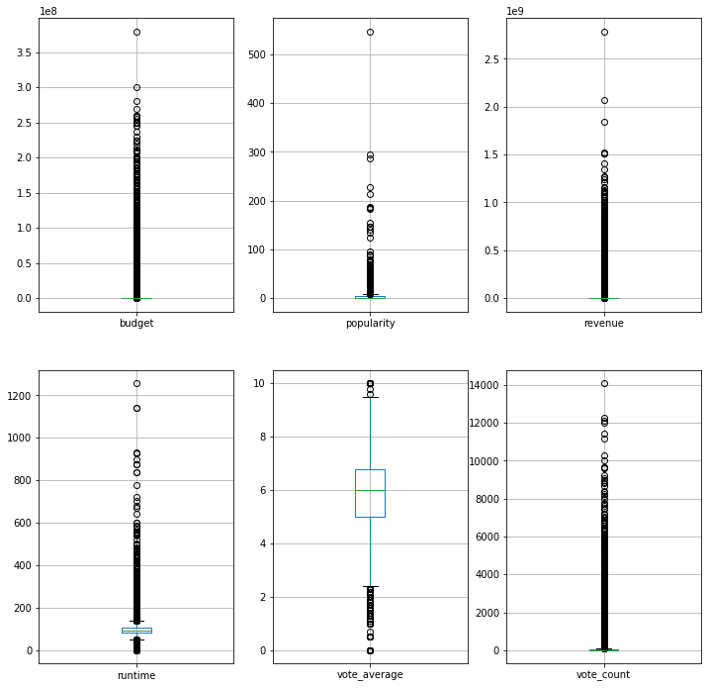
EDA - Outliers
There seemed to be a wide range of data and some outliers.
The zscore was calculated for each data column and anything that was less than 3 standard deviations away was deleted.
This data was saved in a new dataframe called movies_credits_actors_no.

Slide 14
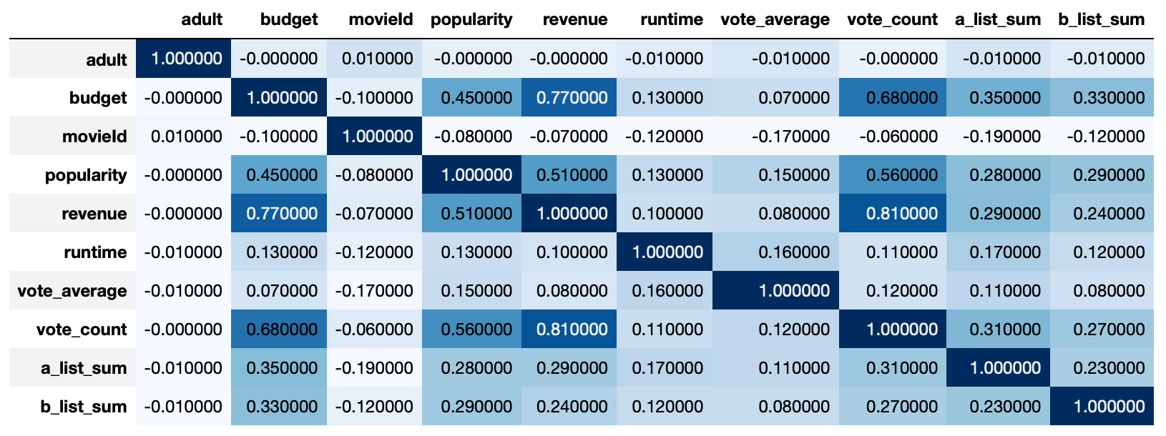
EDA - Correlations
Some data had correlations. All or some of these features should be removed for modeling.
Revenue feature has a correlation with vote_count and budget.
Slight correlation between budget and popularity.

Slide 15
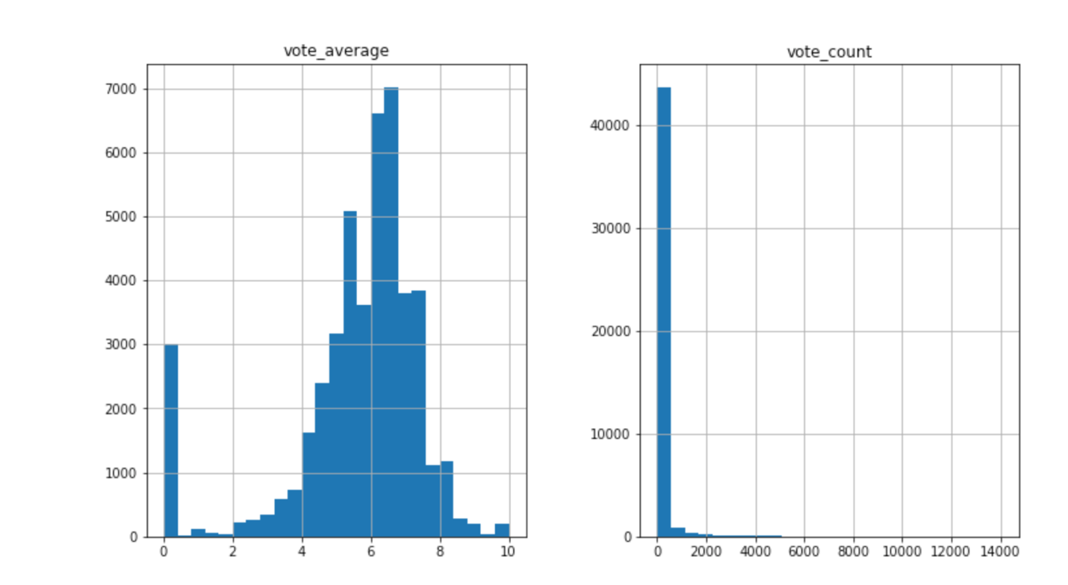
EDA - Distribution
The distribution of the data in the vote_average feature is spread evenly, however there is a large amount of very low scores.

Slide 16
Baseline Modeling
I plan to use three modeling methods:
linear regression,
random forests regressor, and
SVM.
The features I focused on for modeling was to use the popularity, vote_count, budget, revenue, a_list_sum, and b_list_sum for the X and vote_average for the y.
data was split 80/20.

Slide 17
Baseline Modeling
Linear Regression
Score was very low
Training score was 0.0352
Test data score was 0.2996.
Coefficient scores showed that there is a slight relationship between popularity and a_list_sum and b_list_sum and that those features may be good predictors of the movie score

Slide 18
Extended Modeling
Linear Regression
Some correlation with revenue and budget/vote_count, revenue was removed
The training score was 0.0347
Test score was 0.0296
Random Forest Regressor
Training score without revenue was 0.588
Test score was 0.58
The score for the SVR model was -0.0378.

Slide 19
Recommendations and Future Work
Outcome
The modeling scores were very low, and the predictions did not seem to be very accurate. This can be for a few different reasons:
A lot of zeros outside of NaN.
Linear approach wasn’t a great predictor because of the zeros and not a large range within the features.
Random forest was better because it was able to group things into the right ranges but was not specific enough.
Future Considerations
More analysis on zero values that are not NaNs
See if these are true zeros or if the data is just not clean.
Add the keywords file to the dataset
Might provide more useful features that might improve the modeling.
See if there is anywhere to create more features.

